Slide 1

US Workplace Store Sales Dashboard A presentation by Ronojoy Goswami

Slide 2
Objective: Create an interactive sales dashboard for the US Workplace Store for 2014-2017
The US Workplace Store is a retailer of furniture, office suppliers, and technology products from its customers based in the United States. I have collected a dataset of its sales from 2014-2017. As per the given data, I worked on the following:
Sales by Category and use the Drill Down feature to check sales by Category. Add a timeline to check and analyze sales with time.
Profit over Time from 2014-2017 showing profits as per quarters Q1- Q4.
Total Sales in different states.
Top 5 customers with the highest sale amount
Customer count
Clean the given dataset and use conditional formatting to locate the loss in orders.

Slide 3
Below is the first 20 records from the final dataset table used in this project. It also shows the use of conditional formatting to highlight the losses made for certain orders.
Order Date | Customer Name | State | Category | Sub-Category | Product Name | Sales | Quantity | Unit Price | Profit
03-Jan-2014 | Darren Powers | Texas | Office Supplies | Paper | Message Book, Wirebound, Four 5 1/2" X 4" Forms/Pg., 200 Dupl. Sets/Book | $16.45 | $2.00 | $8.23 | $5.55
04-Jan-2014 | Phillina Ober | Illinois | Office Supplies | Labels | Avery 508 | $11.78 | $3.00 | $3.93 | $4.27
04-Jan-2014 | Phillina Ober | Illinois | Office Supplies | Storage | SAFCO Boltless Steel Shelving | $272.74 | $3.00 | $90.91 | -$64.77
04-Jan-2014 | Phillina Ober | Illinois | Office Supplies | Binders | GBC Standard Plastic Binding Systems Combs | $3.54 | $2.00 | $1.77 | -$5.49
05-Jan-2014 | Mick Brown | Pennsylvania | Office Supplies | Art | Avery Hi-Liter EverBold Pen Style Fluorescent Highlighters, 4/Pack | $19.54 | $3.00 | $6.51 | $4.88
06-Jan-2014 | Lycoris Saunders | California | Office Supplies | Paper | Xerox 225 | $19.44 | $3.00 | $6.48 | $9.33
06-Jan-2014 | Jack O'Briant | Georgia | Office Supplies | Art | Dixon Prang Watercolor Pencils, 10-Color Set with Brush | $12.78 | $3.00 | $4.26 | $5.24
06-Jan-2014 | Maria Etezadi | Kentucky | Furniture | Chairs | Global Deluxe High-Back Manager's Chair | $2,573.82 | $9.00 | $285.98 | $746.41
06-Jan-2014 | Maria Etezadi | Kentucky | Office Supplies | Binders | Ibico Hi-Tech Manual Binding System | $609.98 | $2.00 | $304.99 | $274.49
06-Jan-2014 | Maria Etezadi | Kentucky | Office Supplies | Art | Rogers Handheld Barrel Pencil Sharpener | $5.48 | $2.00 | $2.74 | $1.48
06-Jan-2014 | Maria Etezadi | Kentucky | Technology | Phones | GE 30524EE4 | $391.98 | $2.00 | $195.99 | $113.67
06-Jan-2014 | Maria Etezadi | Kentucky | Technology | Phones | Wireless Extenders zBoost YX545 SOHO Signal Booster | $755.96 | $4.00 | $188.99 | $204.11
06-Jan-2014 | Maria Etezadi | Kentucky | Office Supplies | Fasteners | Alliance Super-Size Bands, Assorted Sizes | $31.12 | $4.00 | $7.78 | $0.31
06-Jan-2014 | Maria Etezadi | Kentucky | Office Supplies | Paper | Southworth 25% Cotton Granite Paper & Envelopes | $6.54 | $1.00 | $6.54 | $3.01
07-Jan-2014 | Vivek Sundaresam | Texas | Furniture | Furnishings | Howard Miller 14-1/2" Diameter Chrome Round Wall Clock | $76.73 | $3.00 | $25.58 | -$53.71
07-Jan-2014 | Vivek Sundaresam | Texas | Office Supplies | Binders | Acco Four Pocket Poly Ring Binder with Label Holder, Smoke, 1" | $10.43 | $7.00 | $1.49 | -$18.25
09-Jan-2014 | Melanie Seite | Texas | Office Supplies | Art | Newell 312 | $9.34 | $2.00 | $4.67 | $1.17
09-Jan-2014 | Melanie Seite | Texas | Technology | Accessories | Memorex Micro Travel Drive 8 GB | $31.20 | $3.00 | $10.40 | $9.75
10-Jan-2014 | Anthony Jacobs | Virginia | Office Supplies | Labels | Avery 482 | $2.89 | $1.00 | $2.89 | $1.36

Slide 4
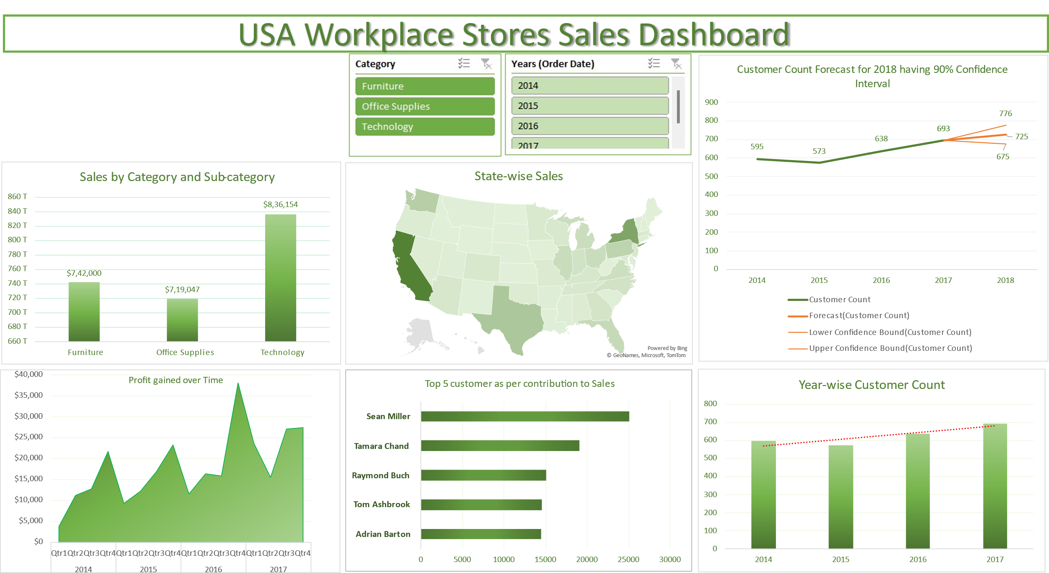
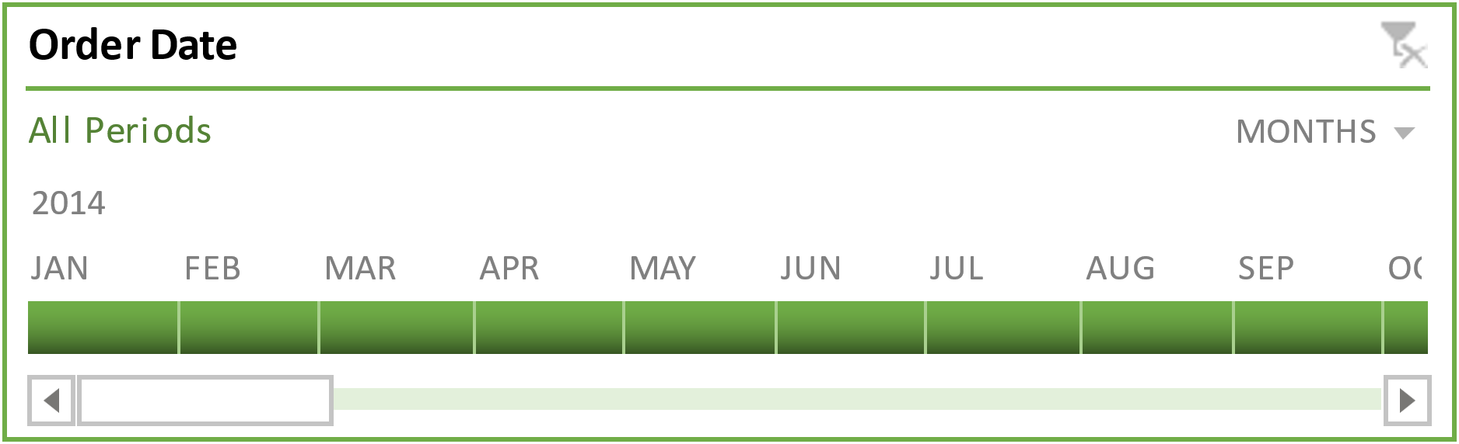

Slide 5
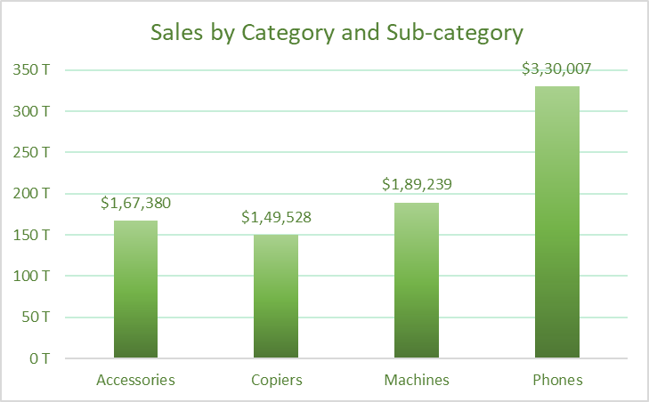
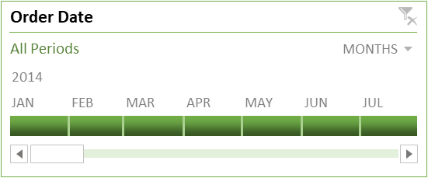
Sales by Category and use the Drill Down feature to check sales by Sub-category. A timeline to check and analyse sales with time.
Before drill-down: Sales by category
After drill-down: Sales by Sub-category for Technology
Timeline to analyze sales with time:

Slide 6
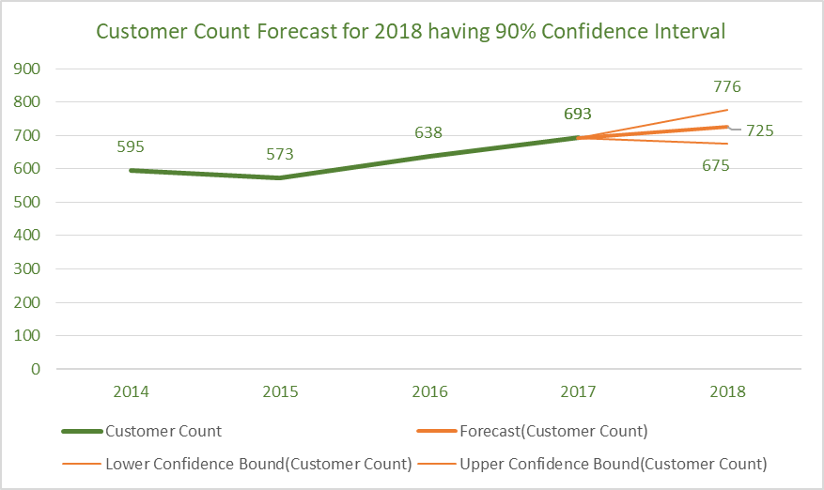
Total number of customers: 795 Top 5 customers contributing to maximum sales amount from 2014- 2017 in descending order are the following:
Sean Miller, Tamara Chand, Raymond Buch, Tom Ashbrook and Adrian Barton.
Year-wise customer count:

Slide 7
Key insights obtained from this project are below:
Phones is the sub-category contributing the maximum sales from 2014-2017.
Each year maximum profit is gained during Q4.
2017 has the maximum profit gained which equals to $93440.
California has the highest sales followed by New York and Texas.
At 90% confidence interval, the customer count (i.e customers who are placing any orders) for 2018 is expected to increase to 725.
Conclusion to improve sales of US Workplace Store: 1. Check for the reasons behind the dip in sales in Q1-Q3 as there is a considerable increase in sales during Q4 every year. If there is no particular drawback, then we may assume it is seasonal sales that experience fluctuations based on seasonal changes, holidays, or other recurring events. The store may introduce exciting offers and promotional ads to increase sales for Q1-Q3.
2. The store needs to promote through content marketing, and new channels and offer special discounts for new customers to keep up the customer growth as the customer growth seems to be significantly slow.
3. Check the states having low sales and further investigate the supply chain process to improve customer relationships, enhance customer acquisition, and provide quality service to increase sales.

